Slide 1
Families + <Organization name> =
Partnership
Notes:
[Type your school/district/organization name on this slide. You can also add your logo]
We are so excited to partner with you this school year in order to support your child’s growth and learning.
You are the expert on your child and we have so much to learn from your entire family.
The more we know about your family, including things like your culture and traditions, and your child’s interests, experiences, and ideas the more we will be able to support your child in the classroom.
Don’t hesitate to reach out and share with us! And let us know if there are ways we can support your entire family!

Slide 2
Ways to reach out:
<insert phone number or other ways for families to reach you>
Notes:
[Type any phone numbers or methods of reaching out that you’d like parents and caregivers to use when connecting with your organization. This is also a nice moment to introduce families to your front of staff- for example, the person who will pick up the phone when they call the office]

Slide 3
You support learning when you:
Have conversations about school
Support great attendance
Enjoy time together with your child
Learn during everyday moments
Talk about your child’s goals & interests
Enjoy family traditions
…and so much more!!
Notes:
Know that you are just the right person to support learning at home!
You help your child thrive in school when you do things like:
Have conversations about school
Support great attendance
Enjoy time together with your child
Learn during everyday moments
Talk about your child’s goals and interest
Enjoy family traditions and so much more!!

Slide 4
Strong partnership between home and school leads to:
Higher grades
Stronger Attendance
Higher graduation rates
Increased social skills
Strong relationships between teachers and families
Better school culture
Notes:
When the partnership between home and school is strong it actually leads to:
Higher grades
Stronger Attendance
Higher graduation rates
Increased social skills
Better relationships between teachers and families
Better school culture

Slide 5
​We are partnering in many ways!
Notes:
This school year we are partnering in lots of ways: [Mention some of the ways you are partnering with families- for example, parent policy councils, learning plans, events, conferences…]

Slide 6
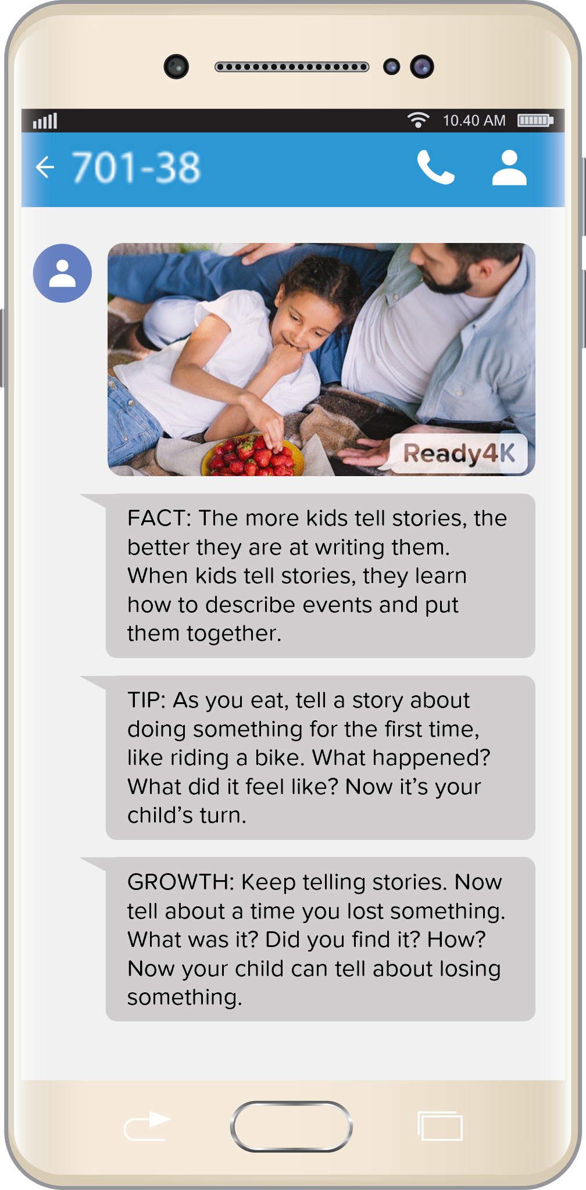
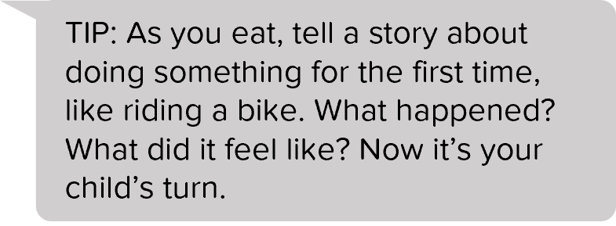
Just-right ways to support learning at home
Quick Tips
Notes:
To support strong partnership we’ll also be implementing ParentPowered. In quick text messages, delivered right to your phone, ParentPowered gives you easy and proven ways to support your child’s learning and development. And all the ideas are matched to your child grade level and come to you in your home language. We chose this program because we wanted to make it as easy as possible for you to support your child outside of school. These tips and activities were built to be super doable at home or on-the-go. They fit within your daily moments and things you’re already doing. They don’t require any supplies of setup. So they don’t add more to your already busy lives.
We also chose this program because [mention how this program is responding to stated goals and needs of your families. For example: we learned in our end of year survey that families wanted more doable ways to support learning at home.]

Slide 7
Why do families love ParentPowered?
94% of parents reported increased confidence
97% said ParentPowered strengthened their
relationship with their child
93% said ParentPowered
helped their child grow
A summary of the voices of 162,941 parents*
“[ParentPowered texts are] better than other information. They’re more focused on the little things and I appreciate that, because those little things make a big difference.”
“I loved getting the messages. I like it because I’m a single mom working full time. It was easy to go, I got this today. I’ll try it tonight.”
“When I’m stressed it’s hard to focus on the kids, the texts helped redirect me, here’s something to think about. Having the reminder was really life saving.”
*Reflects pooled sample across all survey items; survey-level sample sizes vary
Notes:
ParentPowered’s approach is proven to increase learning gains and the program gets great feedback from parents all across the country.
[Delete this slide if you’re sharing your own results in the following slide]

Slide 8
Why do <Organization name> families love ParentPowered?
<If you’ve already enrolled families, add your own survey results here!>
Notes:
[If you already have families enrolled, you can customize this slide with feedback from your own families! You can find survey results and quotes to include in your End of Year Impact Report (https://partner.ready4k.com/resources) or in the Family Engagement Surveys section of the Data and Analytics page (https://partner.ready4k.com/analytics). Copy and paste the results you’d like to share, or download a screenshot of your latest survey results. Upload the screenshot to this slide (Insert > Image > Upload from computer)]
[Delete this slide if you don’t yet have feedback to share from your own families]

Slide 9
Notes:
Becoming a ParentPowered organization is a key step we are taking to meet our collective family engagement goals! Throughout the year you’ll have the chance to weigh in on what’s working, additional support you might want, and new ways you’d like to partner.
[If you plan to enroll families, let them know to look out for their first text. If you plan to ask them to sign up, let them know when and how that will happen.]

